Slide 1

老人科牙齒健康
By
倪 貴 城 牙周治療科專科醫生
Dr. Ngai Kwai Shing Vincent

Slide 2
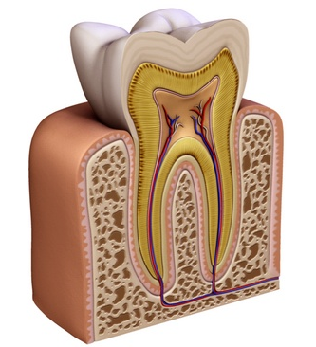
琺瑯質
象牙質
牙骨質
牙髓
牙齦(牙肉)
牙周膜
牙槽骨

Slide 3
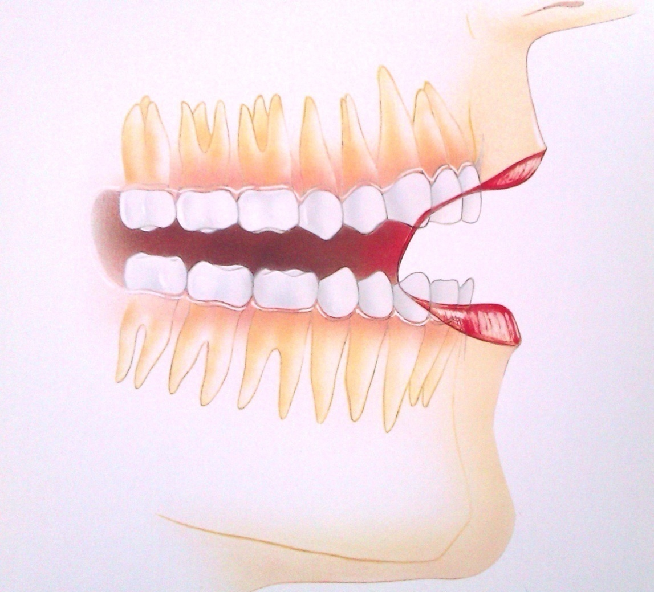
Dental/Oral Structures
mucosa(ulcers, pathology)
lips (Herpes, angular Chilitis)
Tongue (taste, geographic tongue)
Jaws (pathology, inflammation, cyst, impacted tooth, tumour, occlusion),
Salivary glands (mucus retention cyst, tumour)
Temporal mandibular Joint (TMJ pain dysfunction syndrome)

Slide 4
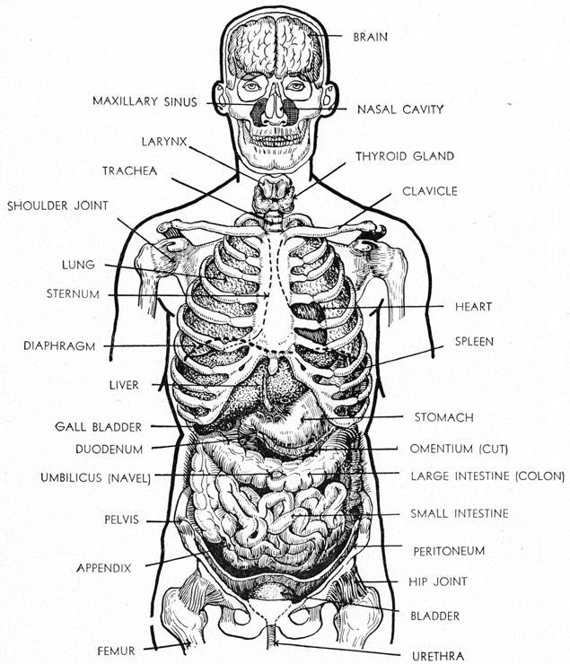
Systemic conditions, Medications
Nutrition, Thrush, ANUG
Inter-relationship with other systemic conditions e.g.-2 ways interations Perio-DM,
Psychological, emotional aspects
Social-economical aspects

Slide 5
常見問題 -從病人的角度看
牙痛
喪失功能 (嘴嚼,說話)
影響外表儀容

Slide 6
常見問題
蛀牙 (牙根表面)
牙周病
牙齒磨損
缺牙
鑲配假牙

Slide 7
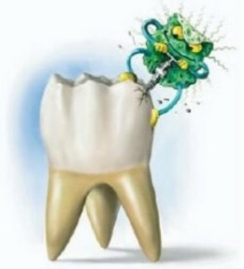
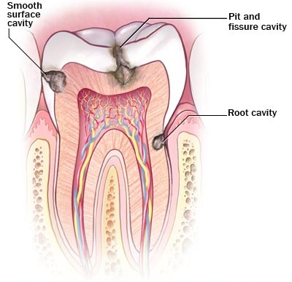
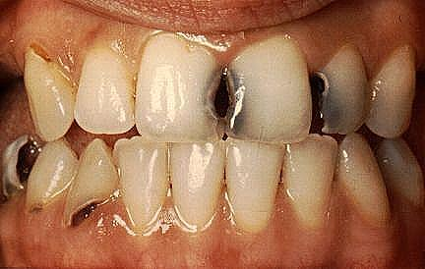
蛀牙
蛀牙 = 牙齒 + 細菌 +糖份 +時間

Slide 8
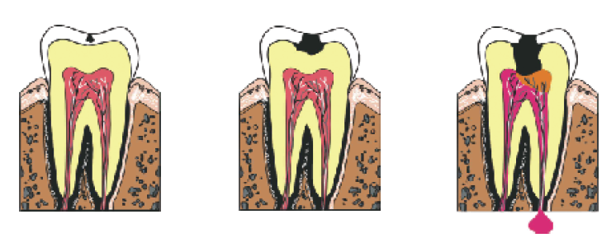
Caries 蛀牙

Slide 9
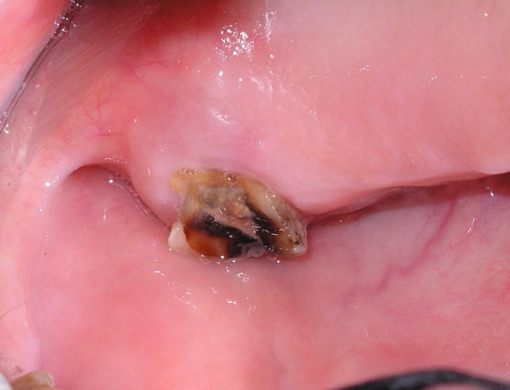
僅餘牙根

Slide 10
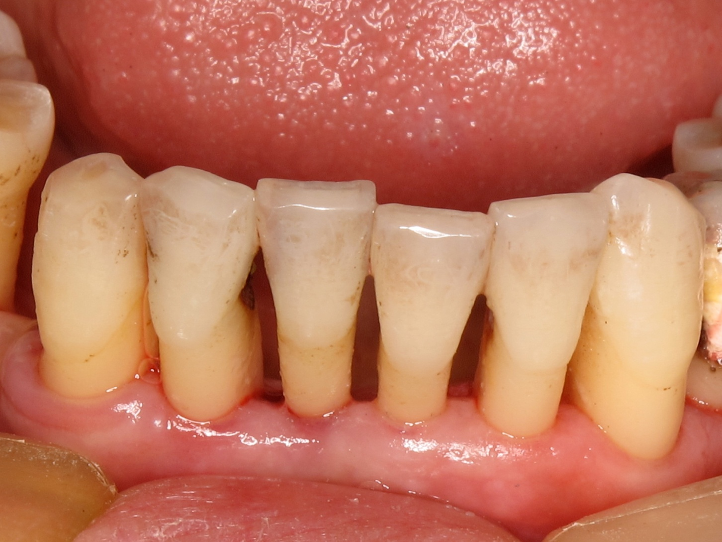

Slide 11
症狀
Sign - Size, location(ID, root), depth(involving pulp), associated with abscess or sinus tract
Symptoms – None, sensitivity, occasional pain, severe spontaneous pain,
Diagnosis – visual, tactile, percussion, X-ray, Electric Pulp Test
Treatment- “Prevention”, Filling, RCT, Crown, Extraction

Slide 12
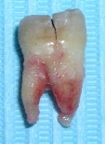
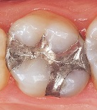
六十五歲至七十四歲的非居於院舍長者
以｢齲失補恆齒｣指數衡量非居於院舍長者的蛀牙經驗 (2001 年及 2011 年)
特
衞生署全港性口腔健康調查

Slide 13
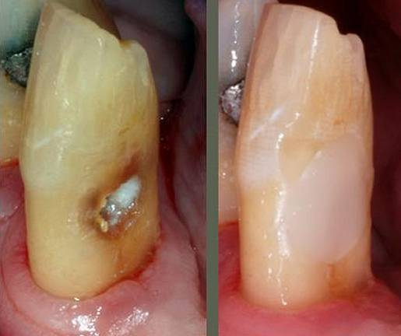
非居於院舍長者牙根表面有蛀蝕經驗的百分率 (2001 年及 2011 年)

Slide 14
有僅餘牙根的非居於院舍長者百分率 (2001 年及 2011 年)

Slide 15
預防蛀牙
Diet- Stephan’s curve
氟化物
?lack of Calcium

Slide 16
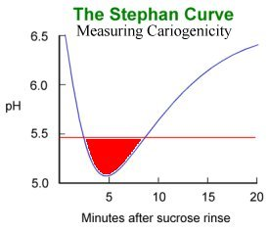
Stephan’s curve

Slide 17
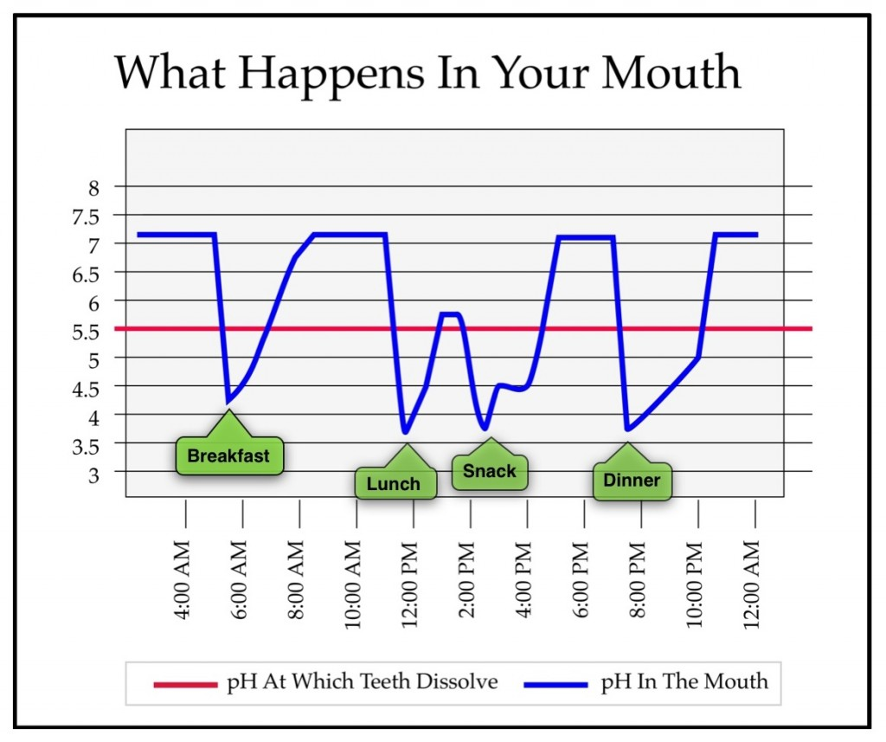

Slide 18
預防蛀牙
Diet- Stephan’s curve
氟化物
?lack of Calcium

Slide 19
一般口腔護理用品的含氟化物比例和使用指引
食水：
在1961年，氟化物開始給加入香港的食水中，自此香港居民的蛀牙率就大大降低。現在香港自來水的氟化物含量是0.5ppm(百萬分之0.5)，只要我們飲用開水，就可從中吸收氟化物，達到預防蛀牙的效果。
成人牙膏1,000－1,450ppm
每天早上起床、晚上睡前使用一顆青豆分量的牙膏刷牙兒童牙膏 500ppm
漱口水230ppm 0.05%NaF
每天一次含在口腔內一分鐘
Source - toothclub.gov.hk

Slide 20
Prevention of Caries
Diet- Stephan’s curve
氟
?lack of Calcium

Slide 21
牙周病

Slide 22
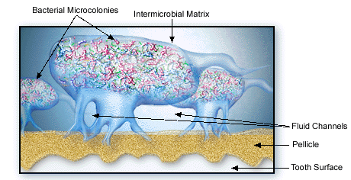
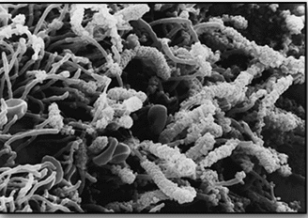
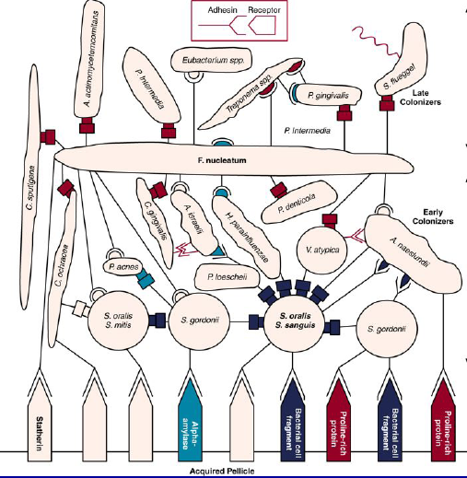
Biofilm 生物膜

Slide 23
症狀
Redness, swelling, bleeding, bad breath, recession, mobile teeth, drifting, Pain and abscess formation, self exfoliation
Pocket formation 牙周袋
Diagnosis- history, clinical examination, probing, radiographs, Pulp test

Slide 24
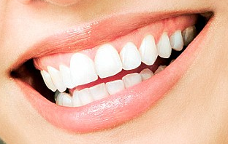
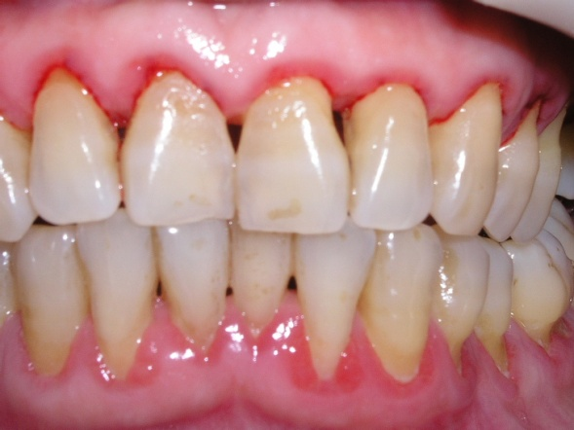
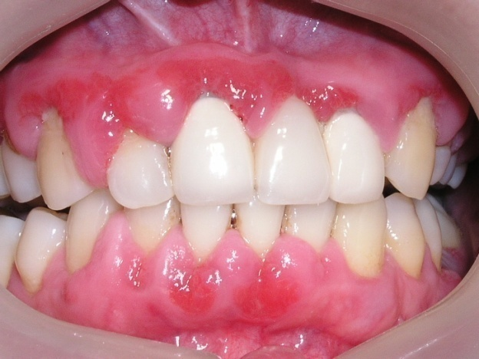
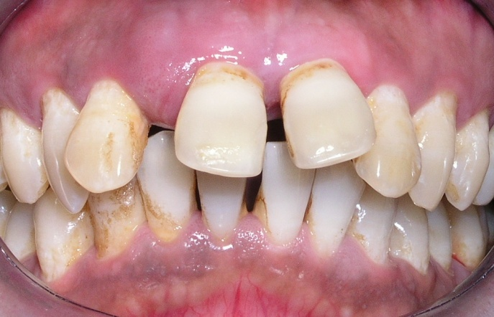
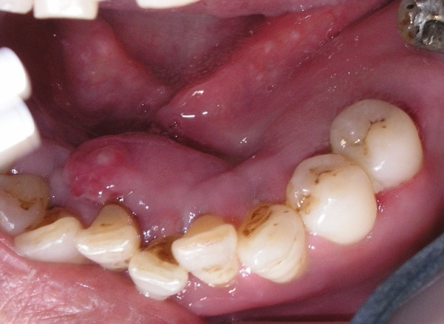
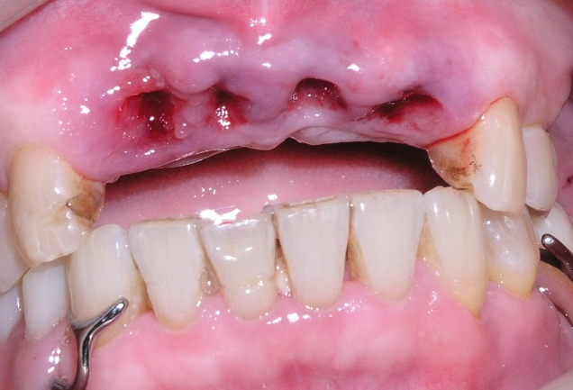
牙周病
Periodontal disease

Slide 25
症狀
Redness, swelling, bleeding, bad breath, recession, mobile teeth, drifting, Pain and abscess formation, self exfoliation
Pocket formation 牙周袋
Diagnosis- history, clinical examination, probing, radiographs, Pulp test

Slide 26
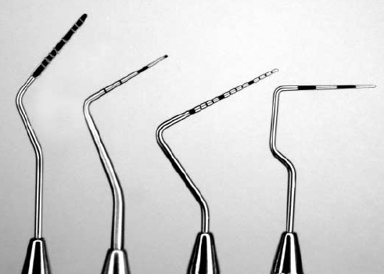
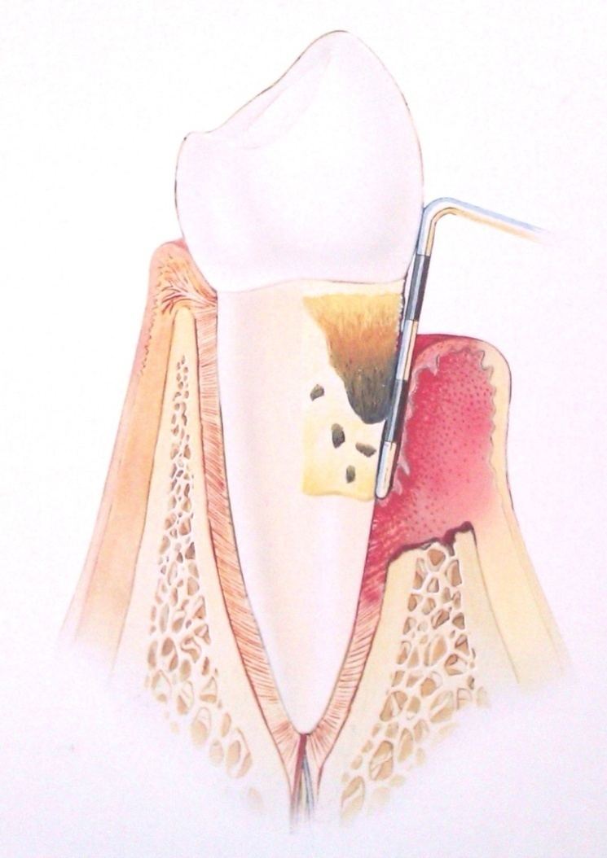
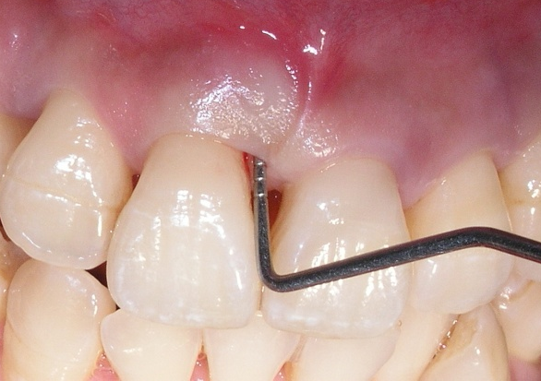
量度牙周袋深度

Slide 27
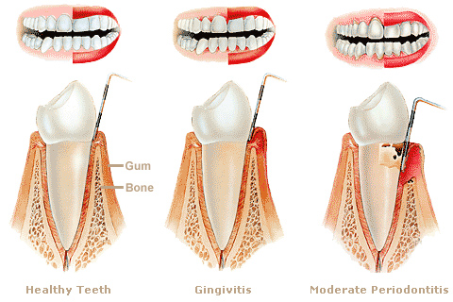
Disease Progression
Experimental gingivitis in man, Loe et al. 1965
The Natural History of Periodontal Disease in Man, Loe et al. 1986

Slide 28
六十五歲至七十四歲的非居於院舍長者
按個人最深牙周袋的深度劃分尚有牙齒的非居於院舍長者的百分率 (2001 年及 2011 年)

Slide 29
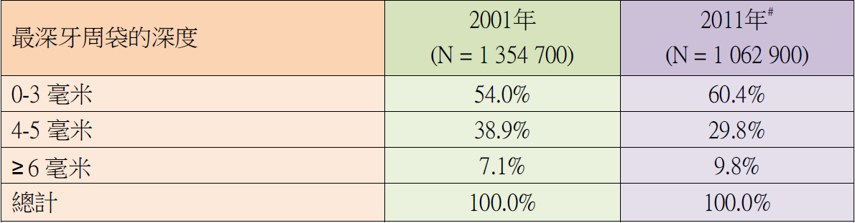
三十五歲至四十四歲成年人

Slide 32
預防牙周病
Prevention – Tooth brushing
Electric tooth brush, modified tooth brush handle
Mouth rinse?
Denture care

Slide 33
按刷牙習慣劃分尚有牙齒的長者的百分率

Slide 34
半數或以上的牙齒有可見牙菌膜覆蓋的長者的百分率

Slide 35
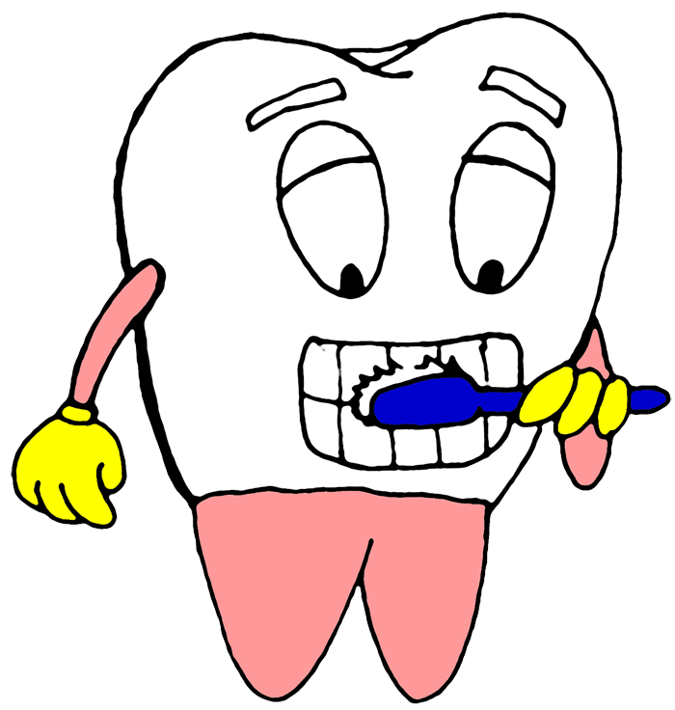
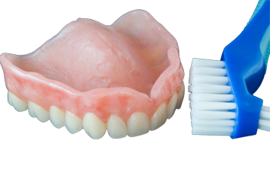
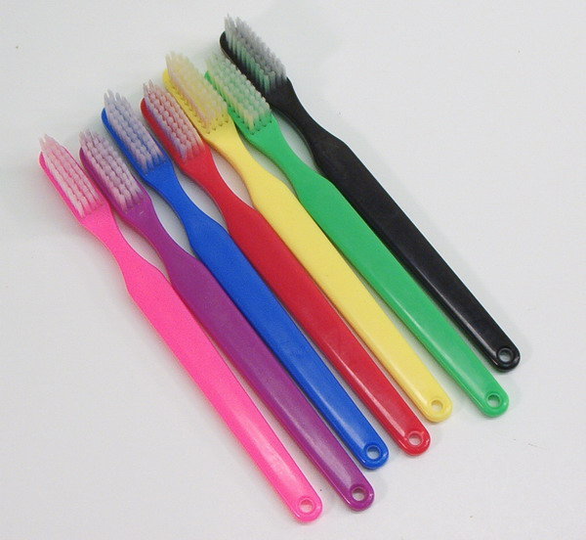
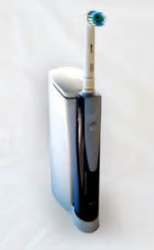
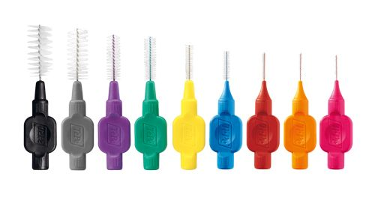
Tooth Brushing Technique
Normal brushing technique
Interdental cleaning
Denture cleaning

Slide 36
清潔牙齒鄰面的習慣

Slide 37
在使用假牙的長者中
88.4% 長者每天使用牙刷清潔假牙
約四分之一 25.4% 長者更輔以假牙清潔劑清潔假牙
接近 80% 長者每天睡覺前會除下假牙托。

Slide 38
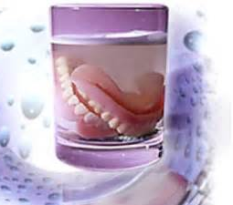
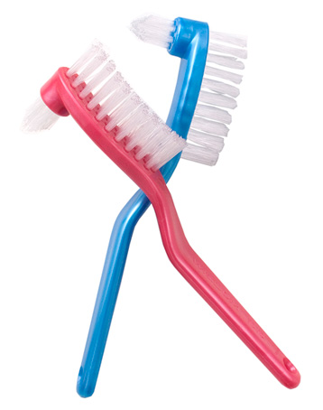
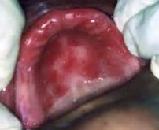
Denture Hygiene

Slide 39
牙齒磨損

Slide 40
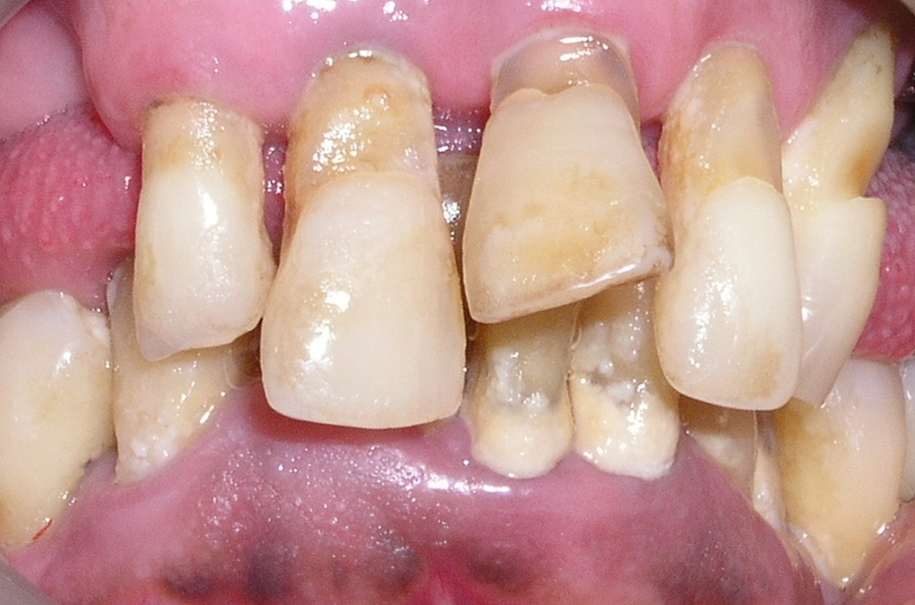
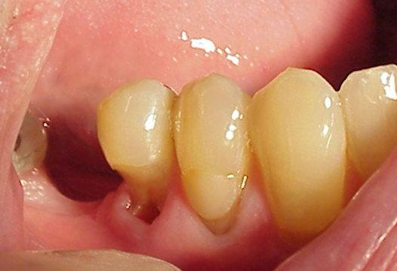
Tooth Wear - Tooth Brush Abrasions

Slide 41
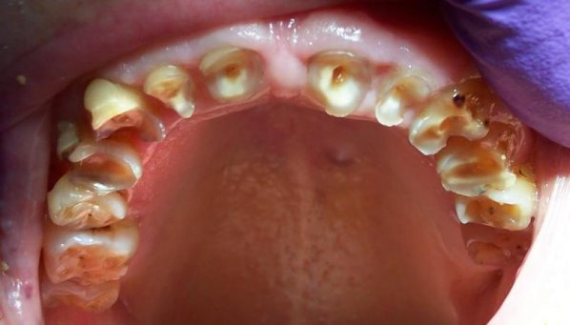
Tooth Wear – Attrition/Erosion

Slide 42
缺牙
按牙齒數目劃分非居於院舍長者的百分率 (2001 年及 2011 年)

Slide 43
非居於院舍長者使用各類假牙的百分率 (2001 年及 2011 年)

Slide 44
Nutrition
Food quality and quantity
Habits, preference, appetite, knowledge, ignorance, money, ability to obtain food, skill to prepare food
Ingestion – Mastication and swallowing
Saliva, time for chewing
Digestion and absorption
Proportion of solid food is directly related to no. of teeth present

Slide 45
Oral hygiene
Dental care
Masticatory function
General health
Nutritional status
Socioeconomic status
Dietary habits

Slide 46
Nutrition
Reduced no. of teeth cause malnutrition?
Reduced no. of teeth is definitely a contributory factor

Slide 47
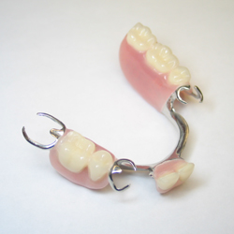
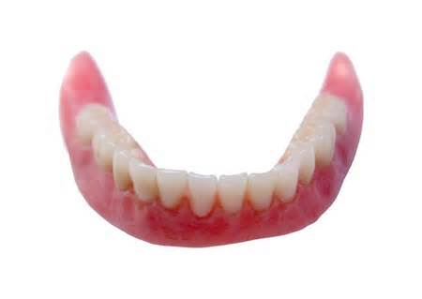
活動牙托
Around two-thirds of NOP had dental prostheses
Need vs Demand

Slide 48
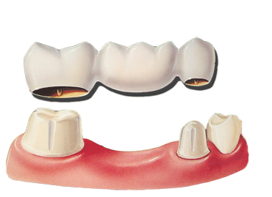
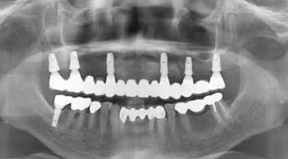
固定牙橋,植牙

Slide 49
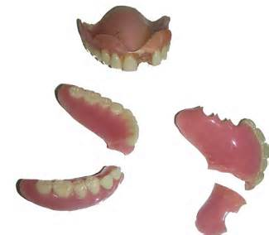
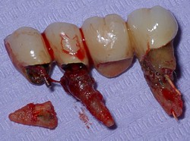
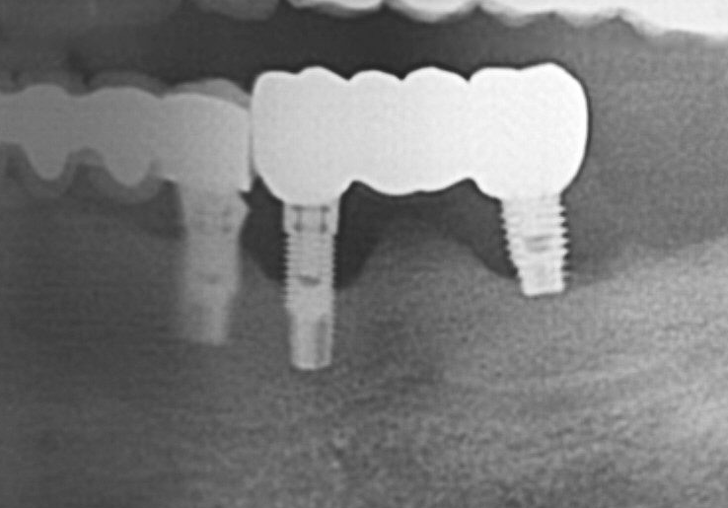

Slide 50
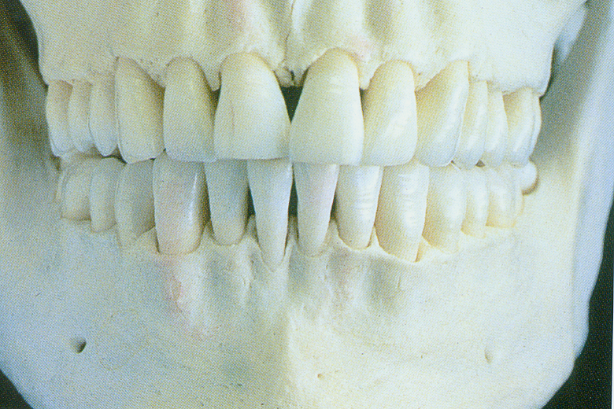
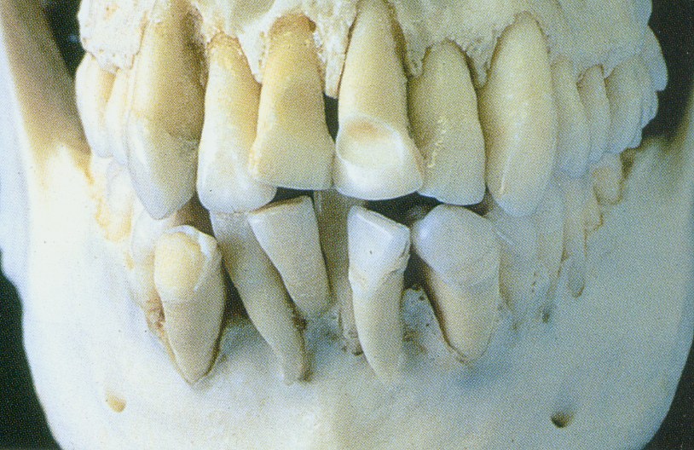
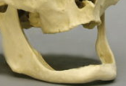
Focus on Prevention
預防 Diet, Self cleaning
及早診斷 Regular dental check-up
治療 Early intervention

Slide 51
長者的口腔健康相關行為
檢查口腔習慣長者的百分率

Slide 53
長者前往的牙科診所類別

Slide 56
Focus on Prevention
預防 Diet, Self cleaning
及早診斷 Regular dental check-up
治療 Early intervention

